Slide 1

Topic: Data Mart Presented by: Shubham Umesh Chavan

Slide 2

Agenda
Introduction to Virtual Data Warehouse?
How Virtual Data Warehouse Works
Key Features
Advantages and Disadvantages of Virtual Data Warehouse
Conclusion
Thank You

Slide 3
InTRODUCTION TO Virtual Data Warehouse
A Virtual Data Warehouse provides logical access to data
Data is not stored physically in one place
Data is fetched from multiple sources in real time

Slide 4
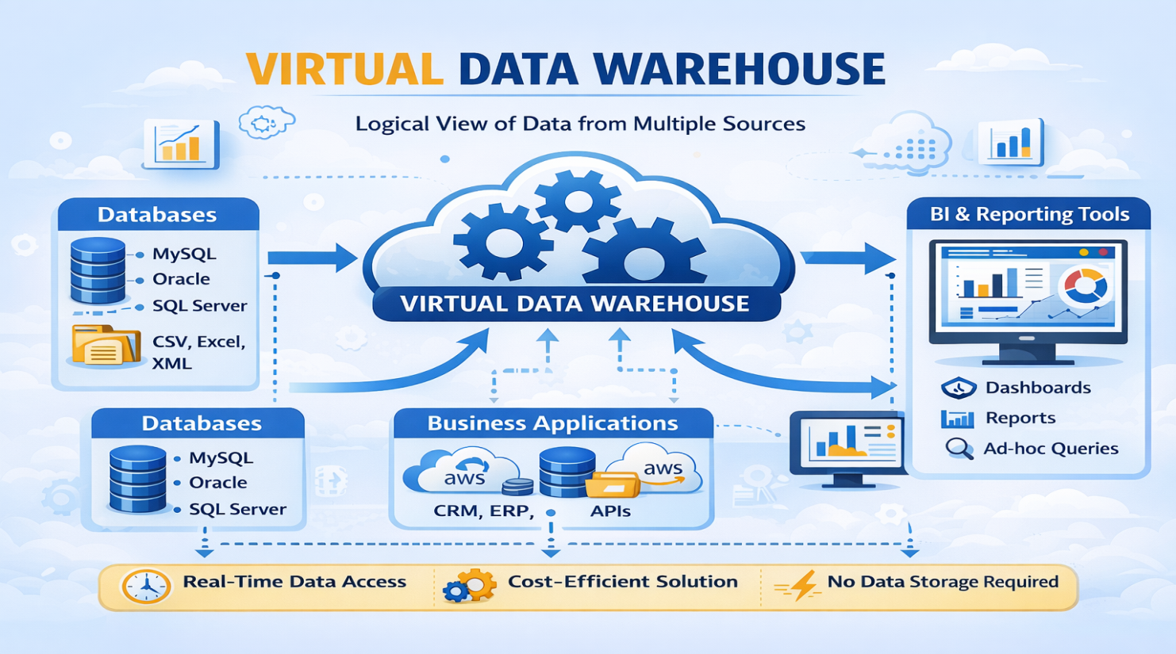
HOW Virtual Data Warehouse works
Provides data access without physically storing data
Combines data from multiple sources in real time
Used when quick access is needed

Slide 5
Data Sources
Databases
Files
Business applications
APIs and cloud applications

Slide 6
Key Features
Real-Time Access
No Data Duplication
Cost-Effective
Reduced Data Latency
Simplified Maintenance

Slide 7
ADVANTAGES of Virtual Data Warehouse
Immediate Data Availability
Reduced Data Redundancy
Improved Agility
Minimal Infrastructure Requirement

Slide 8
DISADVANTAGES OF VIRTUAL DATA WAREHOUSING
Network Dependency
Challenges in Data Consistency
Scalability Limitations
Lack of Historical Snapshots

Slide 9
Conclusion
A Virtual Data Warehouse offers a flexible and cost-effective approach to integrating data from multiple, diverse sources without the need for physical data storage.
It enables real-time access to current data and simplifies maintenance by leaving data at the source. However, it also comes with challenges such as performance limitations, complex query processing, and difficulties in managing historical data and consistent security.
Organizations should carefully evaluate their data needs, infrastructure, and analytical requirements before choosing a virtual data warehouse solution to ensure it aligns with their business goals.

Slide 10


